Slide 1
ECO 304L: Macroeconomics
Final Exam: Study Guide (11am)

Slide 2
FAQ
When: Friday May 3rd, 1pm-2:15pm (JES A121A)
If you have taken exams 1-3: you need a higher % on the final exam for it to replace your lowest exam grade.
If you have missed exam 1, 2 or 3: Your score on the final exam will replace the exam(s) you missed.
Format: 40 MCQ each worth 1 point.
Chapters covered: 6-9; 11-20

Slide 3
FAQ
Is there a sample exam? You will find sample exam files for chapters 1-9; 11-20 on Canvas in the Exam 1, Exam 2 & Exam 3 modules.
Can we review exams 1-3? In the Exam 1, Exam 2 & Exam 3 modules, you will find a master file and the questions for exams 1-3. You can re-take the exam in your own time, without notes, against the clock, then follow up in office hours.
If you miss the final exam, your current grade becomes your final grade.

Slide 4
Allowable Materials
This is a closed book, closed notes exam.
You are allowed the following materials:
1. Physical calculator (any model)
2. A pen / pencil
3. An eraser

Slide 5
Skips Rule
Skip any 3 questions. These are counted as correct.

Slide 6
Preparing for the Exam
1.Watch the lecture recording for each chapter. Go to Canvas, scroll down to Lectures Online (near the bottom).
2. Take the IQ quizzes in review mode.
3. Attempt the end of chapter questions.
4. Attempt the sample exam questions.
5. Re-take exams 1-3.
6. Attend the Supplementary Instruction sessions & office hours (see Canvas announcements for details).
7. You can practice the exam review Kahoots (re-watch the lecture or access them via an app on your phone).

Slide 7
Preparing for the Exam
8. Attend office hours if you need help. Days/times for each TA are on Canvas (click Modules, click office hours at the top).
My availability is Thursday 4/25, 1pm-4pm (BRB 2.102) & Tuesday 4/30, 1pm-4pm (BRB 1.118)

Slide 8
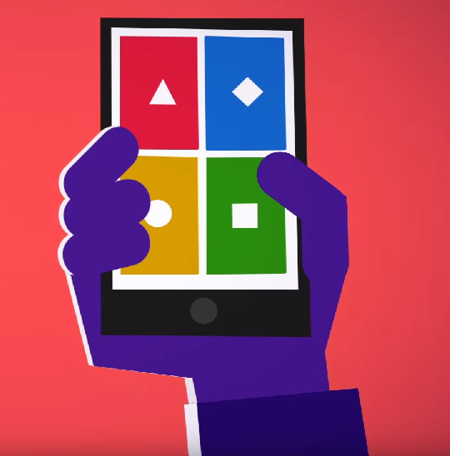
Final Exam Review Kahoot (19 questions)
Launch the Kahoot! app or go to Kahoot.it to play the challenge.
!

